Slide 1

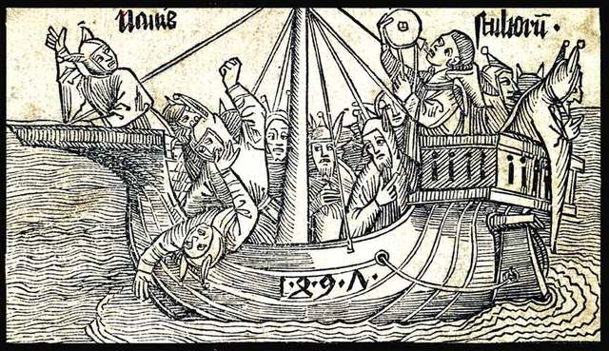
GA 2010
Boldly navigating where no one has gone before
The future of the RASC in the 21st century

Slide 2
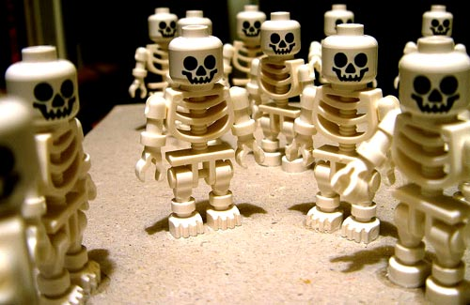
David X
Some other Dave
Guess who?
Dave VIII
Archivist
PJ not just another Dave
DaveXVII
James
Dave XI
Jay
Group Photo RASC GA 2025

Slide 3

Do I have to do it all my bloody self?
It gives me a headache just trying to think down to your level...

Slide 4
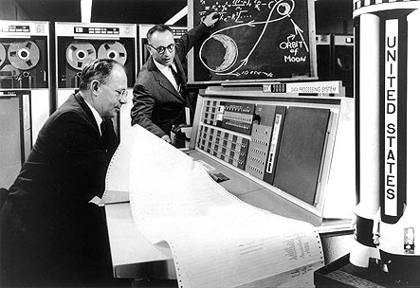
Recent discussion on the Council list
electronic technologies and social networking
citizen science
youth incentives

Slide 5
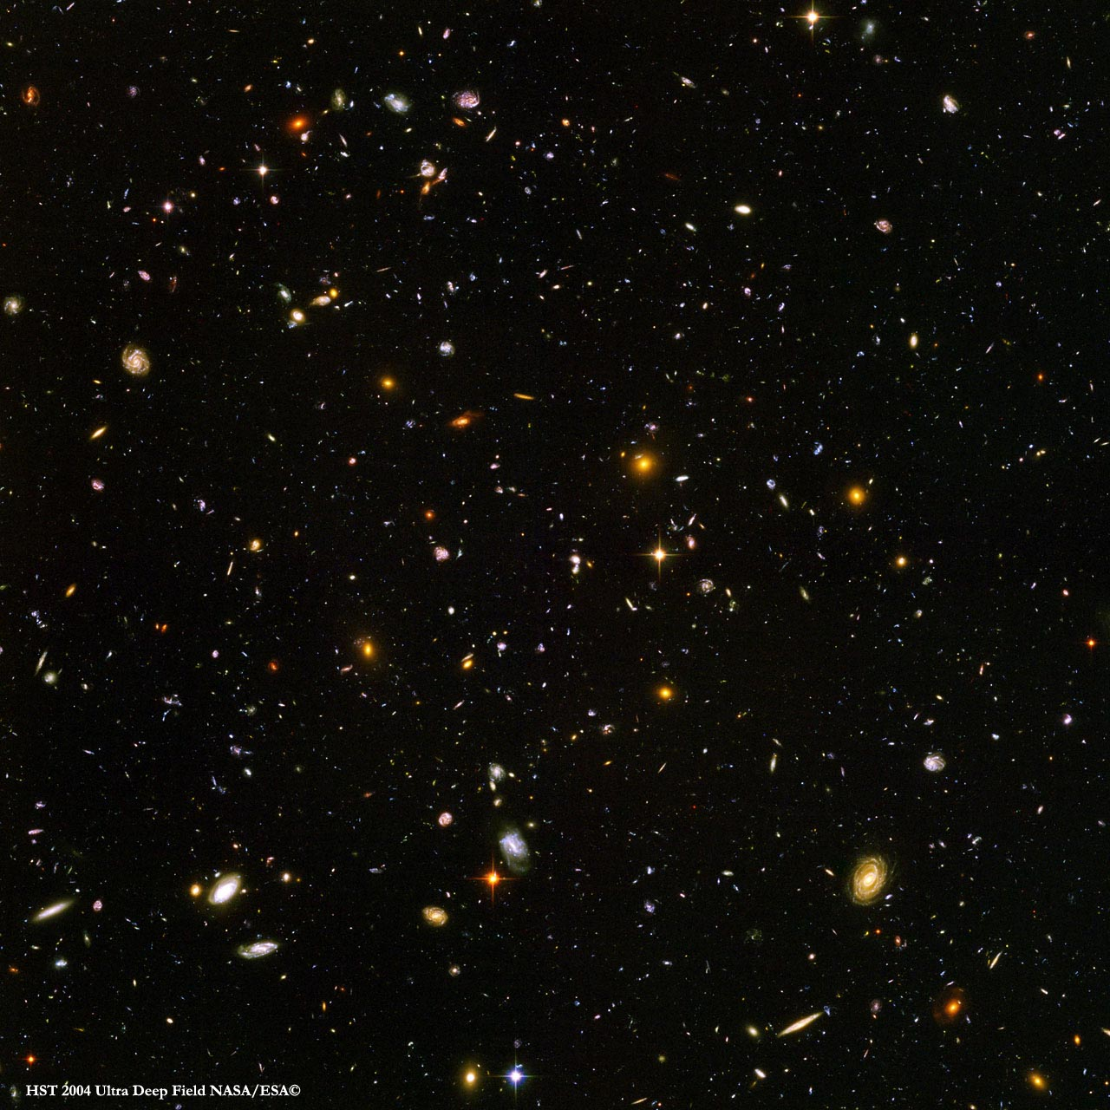
To insure success…
diversity
broad spectrum of astronomical activity
diverse programmes attracting a diversity of people
depth
flexible programmes serving beginners to pros
deep and dynamic = lifetime of astronomical exploration

Slide 6
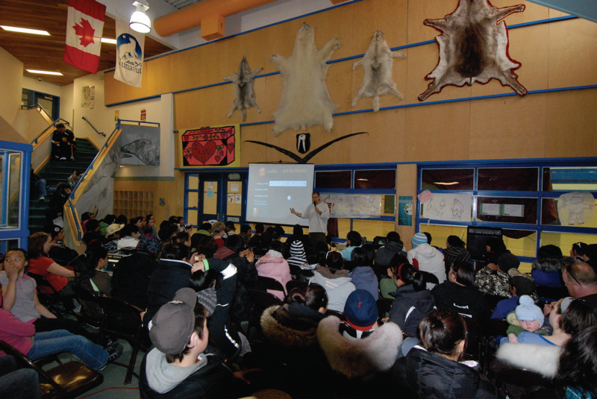
outreach to
under-privileged groups and youth at risk:
the best route to personal and Societal development?

Slide 7
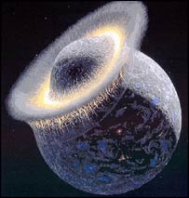
Risk has to be taken
into account…
thorough research
rational plans
reasonable results
First time with the espresso machine?

Slide 8
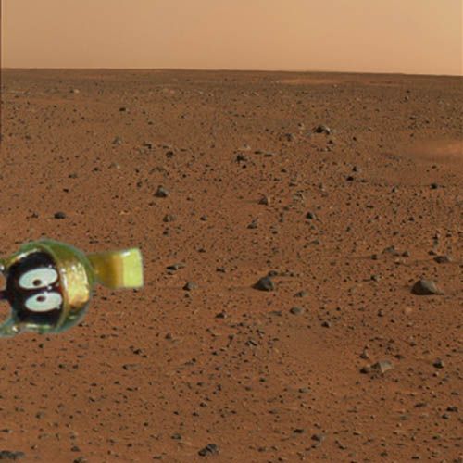
Rise to the challenge!
You never know whom you might meet.

