Slide 1
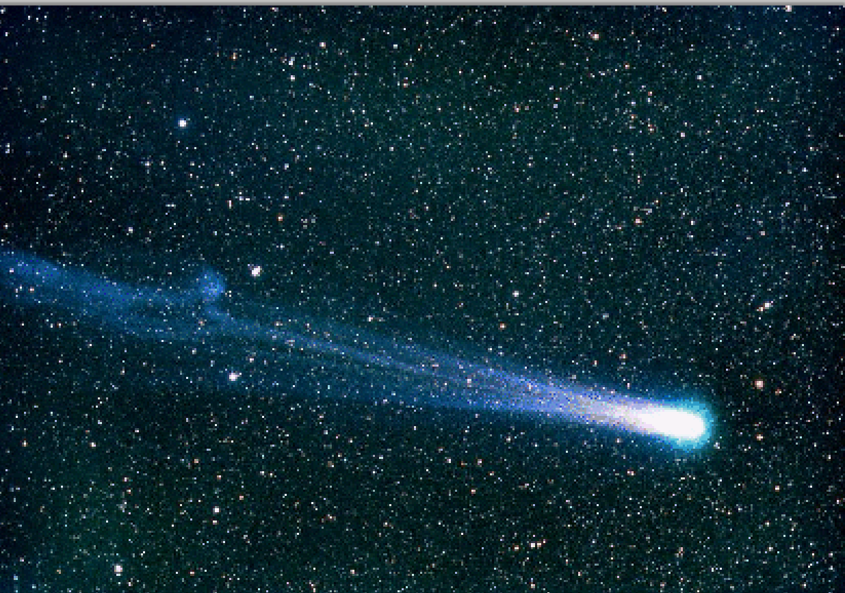
Comets
Visitors from the Edge of the Solar System

Slide 2
Comets are the biggest thing in the Solar System True or false?

Slide 3
Comets are the biggest thing in the Solar System True or false?
True
While the comet nucleus can be only a few kilometers across, the tail can extend for an astronomical unit. The Sun itself is only 1/100 of an astronomical unit in diameter.

Slide 4
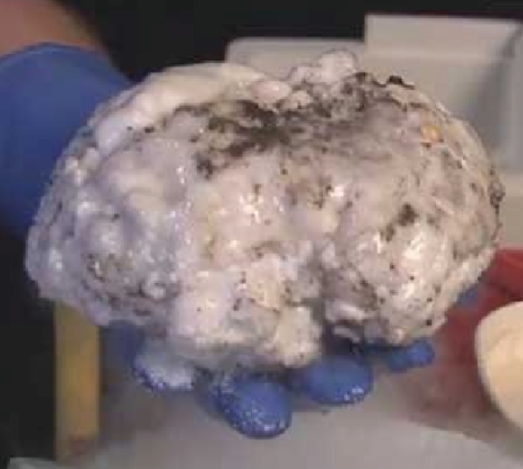
Model of comet nucleus
How like comet:
frozen dry ice, water and mud
simple chemicals like ammonia, sugar and alcohol
How not like a real comet
real comet nuclei are as black as asphalt
some comets are dirty snowballs, others snowy dirtballs

Slide 5

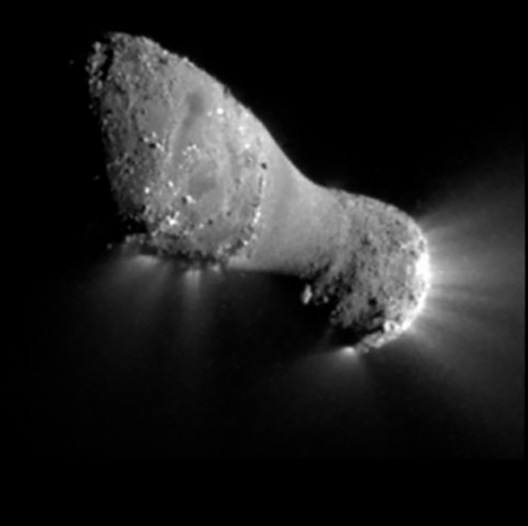
How big are comet nuclei?

Slide 6
How big are comet nuclei?
Town or small city.

Slide 7
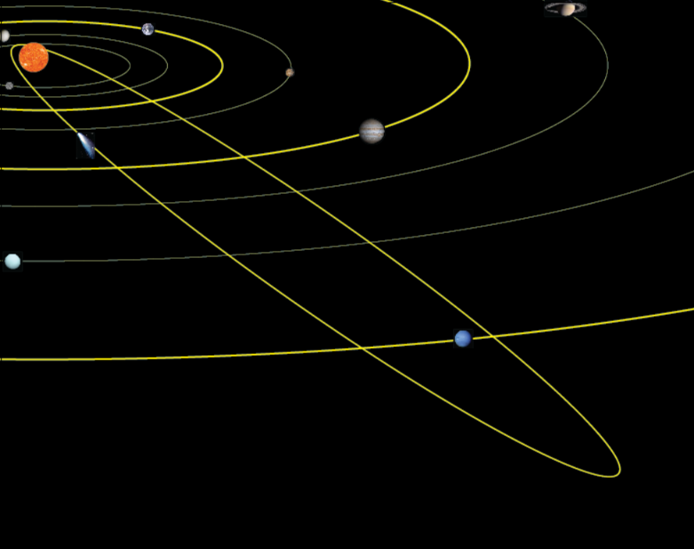
Most comets move in very elliptical orbits. They speed up when close to the Sun, so a comet might take a century for an orbit and pass near us in a few months.
Note the tail is pushed away from the Sun by the solar wind and light pressure. As the comet moves away from the Sun the tail is ahead of it.

Slide 8
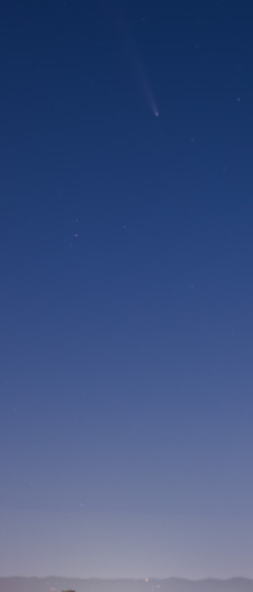
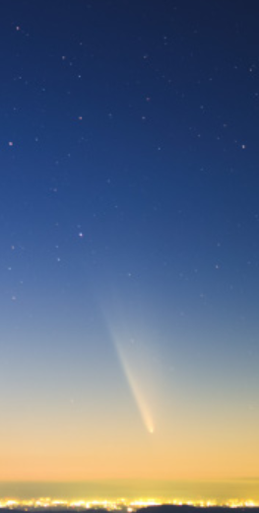
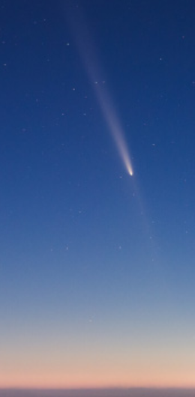
View of comet on day 1,3 and 6. It quickly gets fainter and moves further from the Sun.

Slide 9
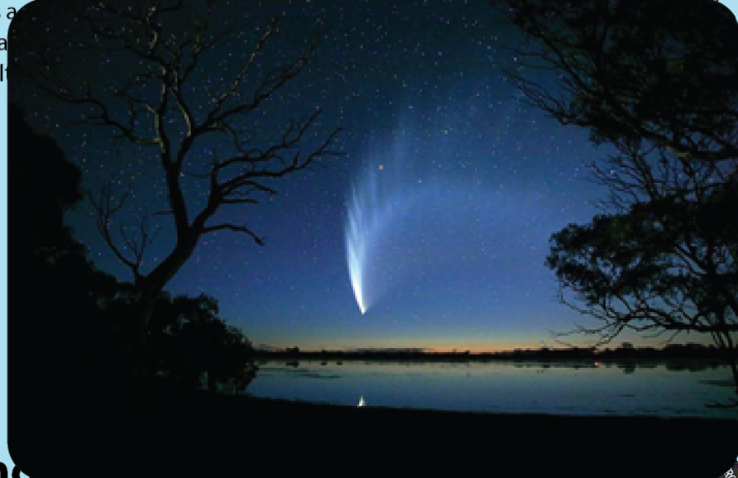
Comet McNaught put on a wonderful show in early 2007 as it went tightly around the Sun.
Do comets gain or lose mass?

Slide 10
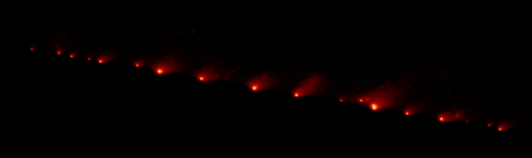
Eventually comets lose mass, break into pieces and stop releasing substances to form a tail. Sometimes they break apart and/or hit a planet or the Sun. Comet Shoemaker Levy 9 fell into Jupiter in 1994 after breaking apart into many pices as shown in the picture.
Many comets only make 100 orbits. So where do new comets come from?

Slide 11
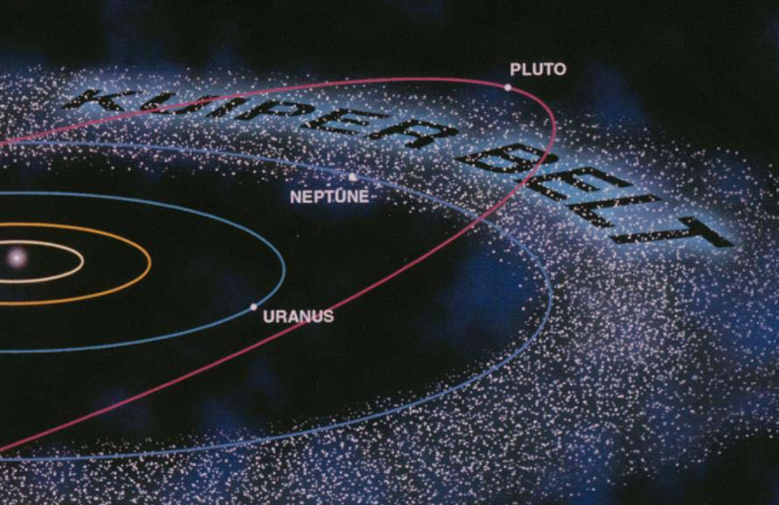
Astronomers predicted and eventually found a large reservoir of comets outside the orbit of Neptune. Pluto is the most famous Kuiper Belt object. From time to time they get deflected inward by passing close to another object out there.

Slide 12
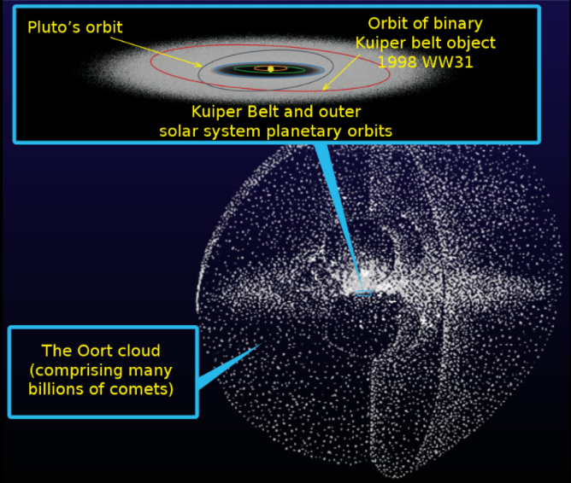
Outside of that is a larger reservoir of comets in all directions. The Oort cloud extends over half way to the nearest star.

Slide 13
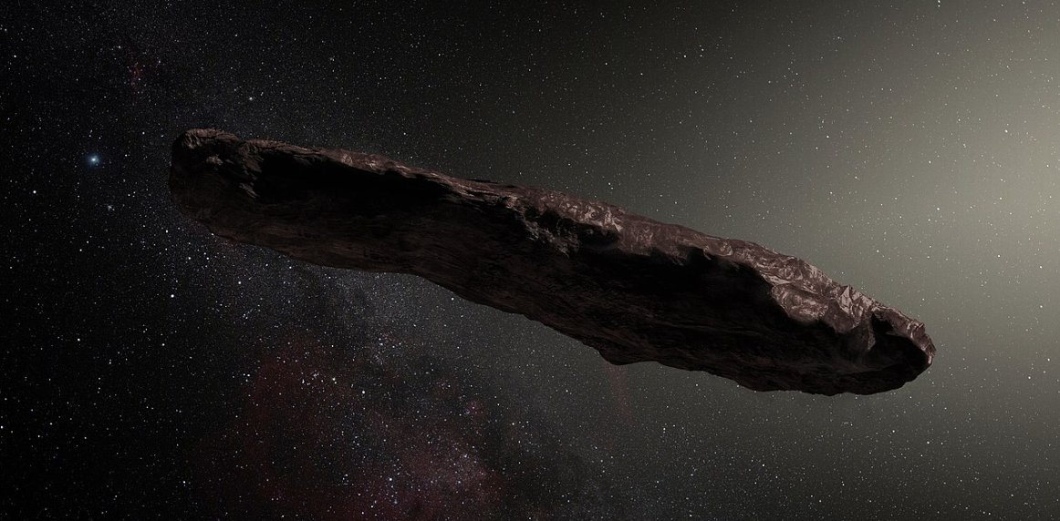
Oumuamua (2017) and Borisov (2019) move so fast they must have come from other stars. Omuamua (meaning “scout” in Hawaian) changed brightness so much that astronomers think it tumbled with a shape like this drawing.

